Slide 1
Large Language Models for Generative AI
Dr. Monali Mavani

Slide 2

Large Language Models for Generative AI
Disclaimer and Acknowledgement
The content for these slides has been obtained from books and various other source on the Internet
I here by acknowledge all the contributors for their material and inputs.
I have provided source information wherever necessary
I have added and modified the content to suit the requirements of the course

Slide 3
Agenda
Fine-tuning
Instruction fine tuning(IFT)
Parameter Efficient Fine tuning (PEFT)
  Prompt and Prefix tuning
  Adapters
  LoRA and QLoRA
Model Merging

Slide 4
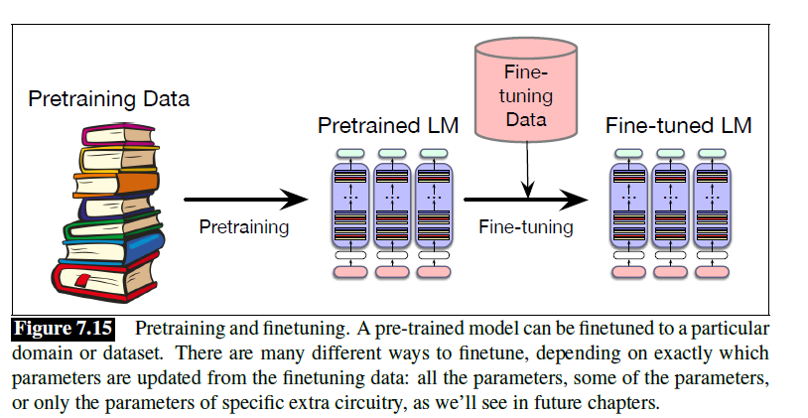
Fine-tuning
Continued pretraining : Training objective/stage where a pretrained model is further trained on new unlabeled text with the original language-modeling objective e.g. BioBERT
Full Fine-Tuning: update all model weights e.g. Qwen/Qwen2.5-0.5B
PEFT: fine-tunes only a small part of the model, not all weights, to save compute and memory e.g. Llama-family adaptations

Slide 5
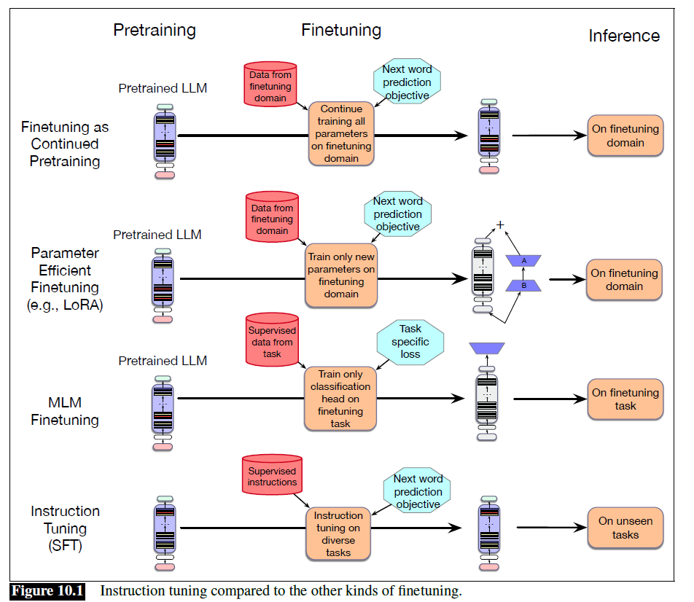
Fine tuning
SFT: train on labeled input-output examples e.g Llama 2-Chat
IFT(Type of SFT): train on instruction-response examples to improve instruction following .e.g Llama 3.1 Instruct
MLM fine-tuning (Type of SFT): adapts BERT-style models to a new domain e.g. DistilBERT

Slide 6
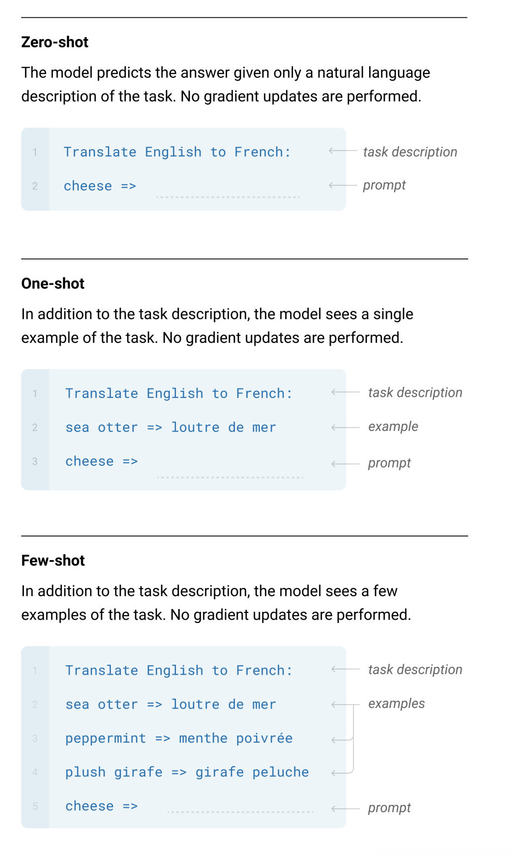
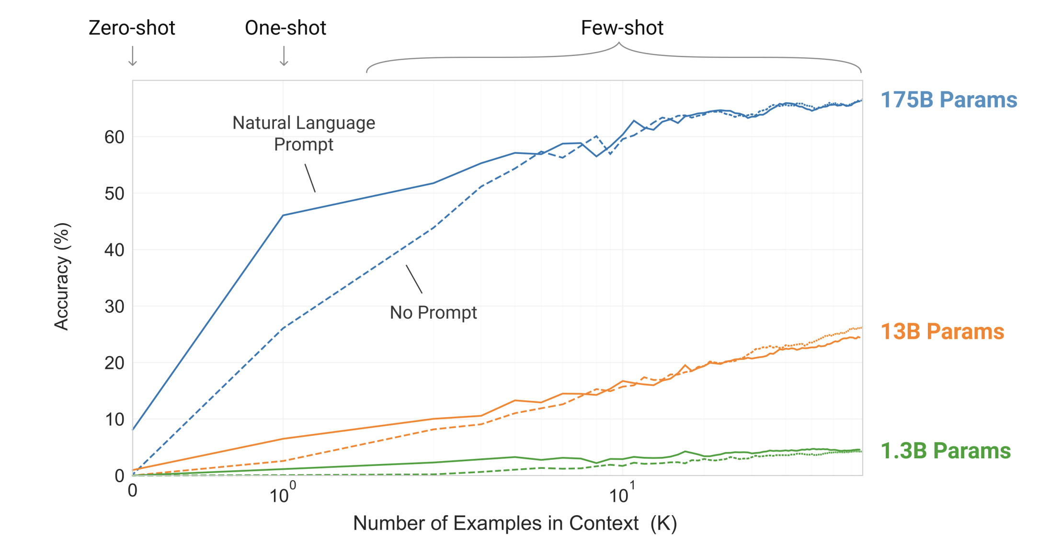
Few shot learning
GPT 3 showed the world that LLMs could perform tasks beyond what it was trained on.
This ability to learn from the input context, know as in-context learning, can be used to leverage the inherent abilities and knowledge the model gained through pre-training.

Slide 7
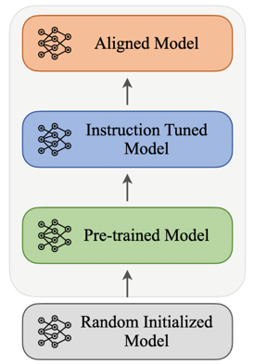
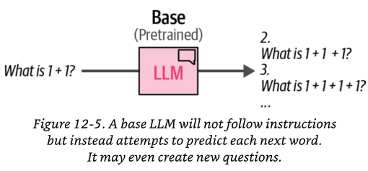
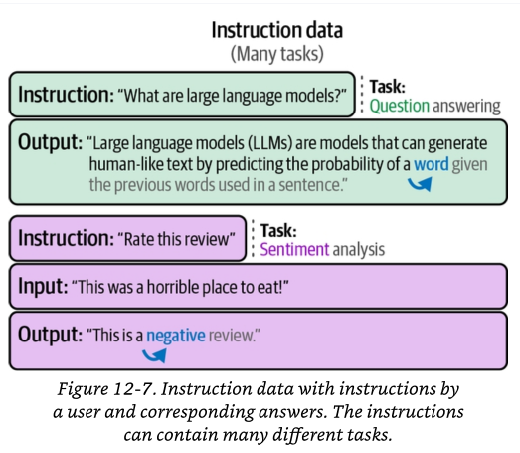
Instruction fine tuning
Observed behavior: Next word prediction
Desired Behavior: Instruction Following

Slide 8
IFT Data Preparation
Human Authoring
  Experts or annotators write instruction-response pairs directly from scratch
Template Conversion
  Existing labeled NLP datasets (SQuAD) are rewritten into instruction format
Synthetic Generation
  A stronger teacher LLM (GPT-4, Claude) generates instructions, answers, or both automatically
  Example: Self-Instruct
Hybrid Pipeline
  Small gold set → synthetic expansion → human validation loop → final IFT dataset
IFT dataset can be stored in JSONL (JSON Lines) — one training record per line, and read natively by HuggingFace load_dataset()

Slide 9
Dataset schema
Stored Schema (model-agnostic JSON), never changes regardless of which model you train
Raw Data (from SQuAD 2.0)
{
"instruction" : "Answer the question using only the information in the context. If the answer is not present, say 'The answer is not present in the provided context.'",
"input" : "Context: The Eiffel Tower is located in Paris, France. It was constructed between 1887 and 1889. It stands 330 metres tall.\n\nQuestion: When was the Eiffel Tower built?",
"output" : "The Eiffel Tower was built between 1887 and 1889.",
"task_type" : "question_answering",
"source_dataset" : "squad_v2"
}
Context : The Eiffel Tower is located in Paris, France.
It was constructed between 1887 and 1889.
It stands 330 metres tall.
Question : When was the Eiffel Tower built?
Answer : between 1887 and 1889
Template Rendering (model-specific)
Mistral Instruct
<s>[INST] Answer the question using only the information in the context.
If the answer is not present, say 'The answer is not present in the provided context.'
Context: The Eiffel Tower is located in Paris, France.
It was constructed between 1887 and 1889. It stands 330 metres tall.
Question: When was the Eiffel Tower built? [/INST]
The Eiffel Tower was built between 1887 and 1889.</s>

Slide 10
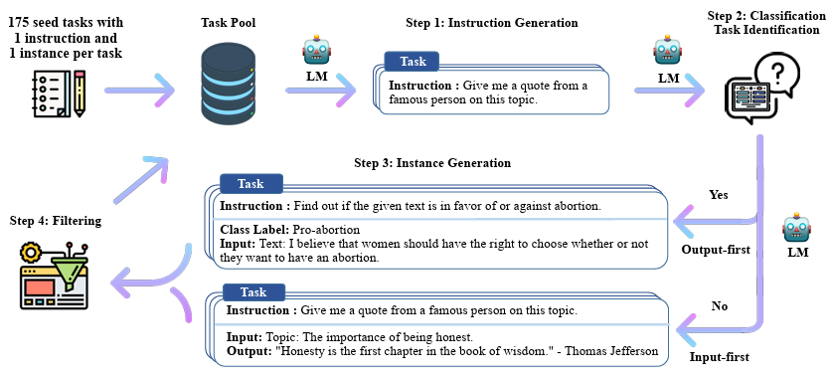
SELF-INSTRUCT
A semi-automated process for instruction-tuning a pretrained LM using instructional signals from the model itself, Base model – GPT-3
Given: 175 seed tasks with 1 instruction and 1 instance per task
Objective: Generate new instructions, Generate examples for each instruction
Classify whether the generated instruction is a classification task
SELF-INSTRUCT: Aligning Language Models with Self-Generated Instructions

Slide 11
Parameter efficient fine-tuning (PEFT)
Why? GPUs don’t grow on trees
As models get larger and larger, full fine-tuning becomes infeasible to train on consumer hardware
Storing and deploying fine-tuned models independently for each downstream task becomes very expensive as fine-tuned models are the same size as the original pretrained model.

Slide 12
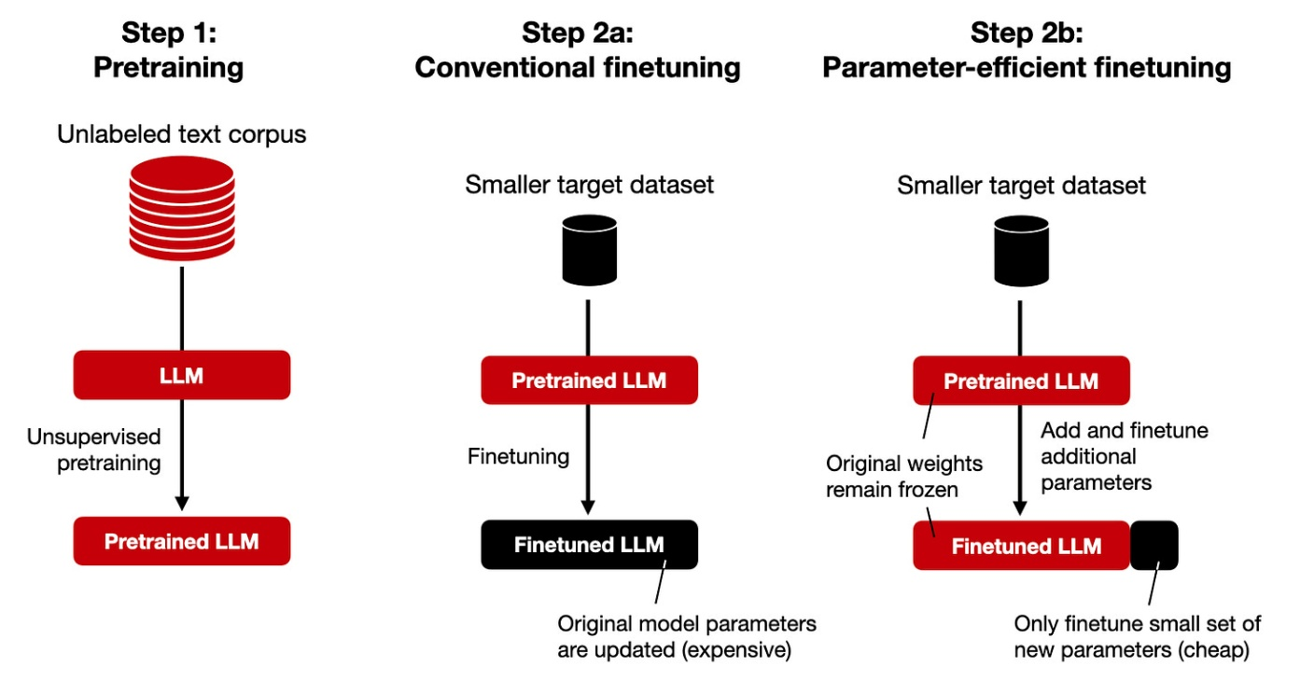
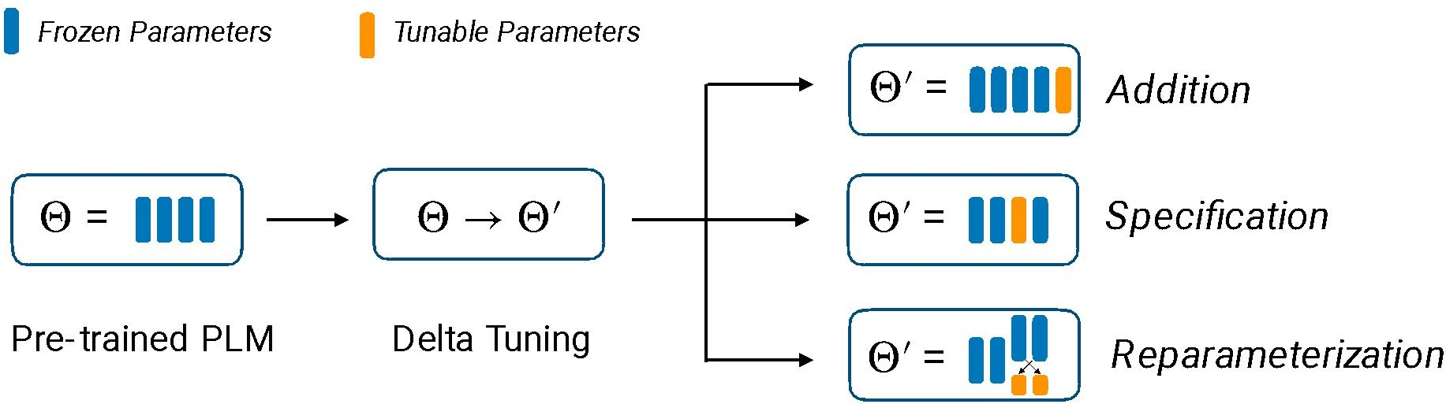
Parameter efficient fine-tuning (PEFT)
PEFT: Adapt large pretrained models by tuning only a small subset of parameters
Three Categories
  Addition: Add trainable modules, Prompt tuning, Prefix tuning, Adapters
  Selective tuning: Tune selected existing parameters, Layer freezing, BitFit, Diff pruning
  Reparameterization: Learn efficient update forms, LoRA
Image Credits : https://magazine.sebastianraschka.com/p/finetuning-llms-with-adapters
Image Credit :CMU : Large Language Models: Methods and Applications

Slide 13
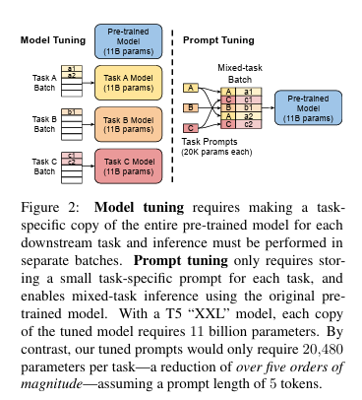
Prompt Tuning
Hard prompt tuning changes the wording of discrete text prompts, such as rephrasing an instruction like “Translate this to German,” so the prompt tokens themselves are not differentiable.
Soft prompt tuning keeps the pretrained model frozen and learns a small set of continuous prompt embeddings through backpropagation.
  These learned prompt vectors are attached to the input representation and act as task-specific signals for the model

Slide 14
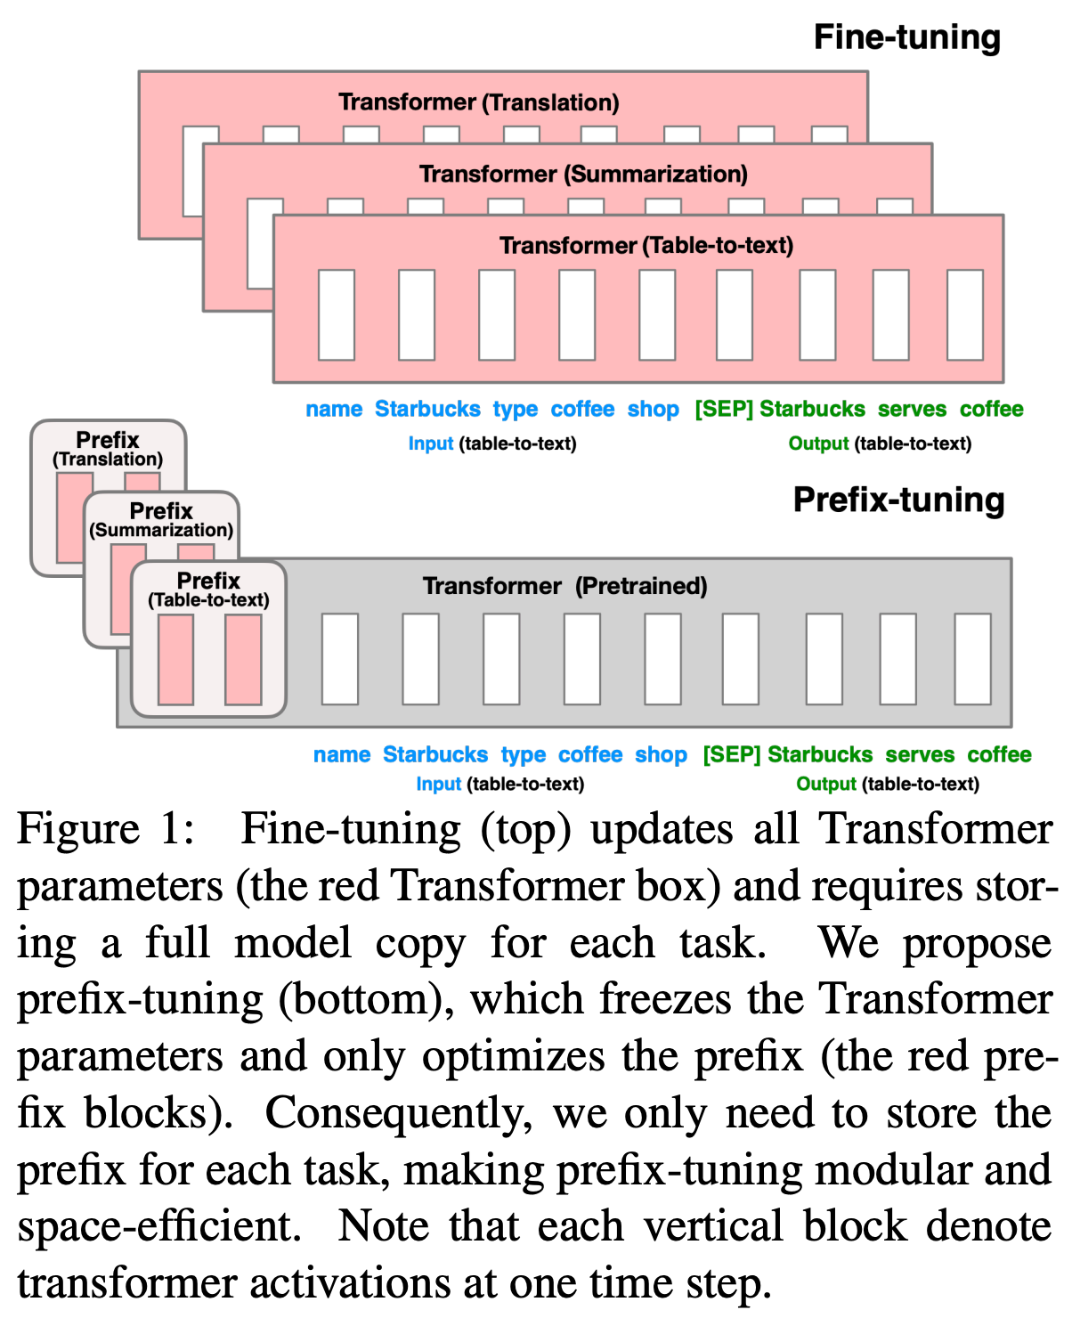
Prefix tuning
Extends soft prompting by inserting trainable prefix vectors into all transformer layers instead of only the input embedding layer
However, these added vectors do not correspond to a specific word or token—we train the entries of these vectors just like normal model parameters.
freeze all model parameters and train only a small set of prefix token vectors added to the model’s input layer for each task.
These trainable prefix tokens can be shared across a task
Many extensions exists.
Prefix-Tuning: Optimizing Continuous Prompts for Generation

Slide 15
Prefix tuning Vs Soft prompt tuning
Prefix tuning adds extra task-specific information at several layers of the model. So, it changes more parts of the model than soft prompt tuning
Soft prompt tuning changes only the input prompt embeddings. Because of this, soft prompt tuning trains fewer parameters and is easier to run
Prefix tuning may give better performance because it can influence the model more deeply
But it also needs more computation and may overfit more easily
Soft prompt tuning is more efficient, but its performance may be lower on difficult tasks

Slide 16
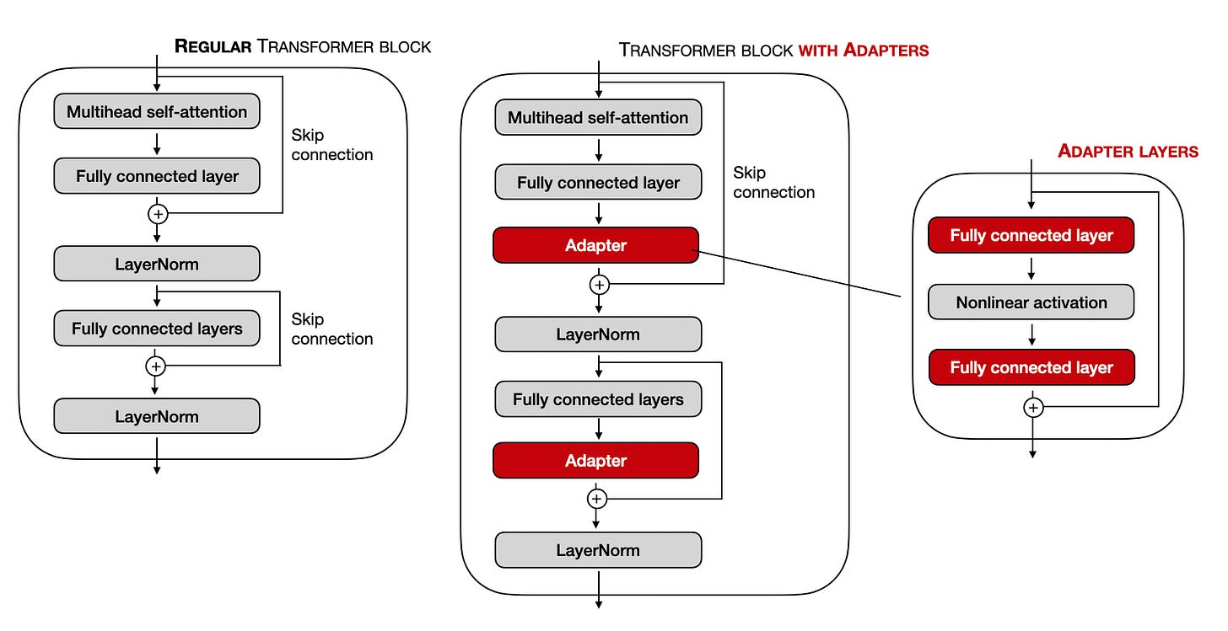
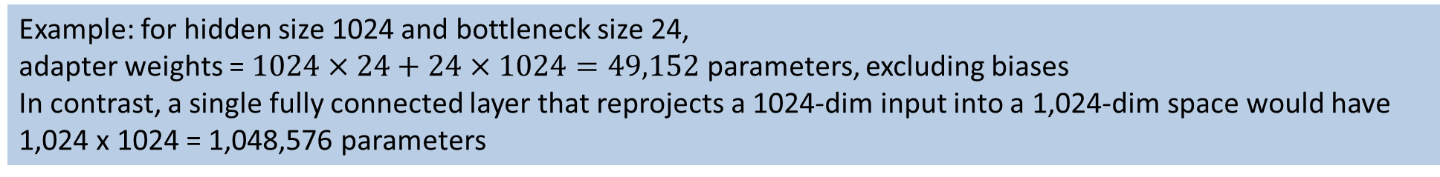
Adapters
Adapters are lightweight trainable modules inserted into a pretrained transformer.
The pretrained backbone remains frozen; only adapter parameters are optimized.
A standard bottleneck adapter performs down-projection, nonlinearity, and up-projection with a residual connection
Example: for hidden size 1024 and bottleneck size 24,
adapter weights = $1024×24+24×1024=49,152$ parameters, excluding biases
In contrast, a single fully connected layer that reprojects a 1024-dim input into a 1,024-dim space would have 1,024 x 1024 = 1,048,576 parameters
https://magazine.sebastianraschka.com/p/finetuning-llms-with-adapters

Slide 17
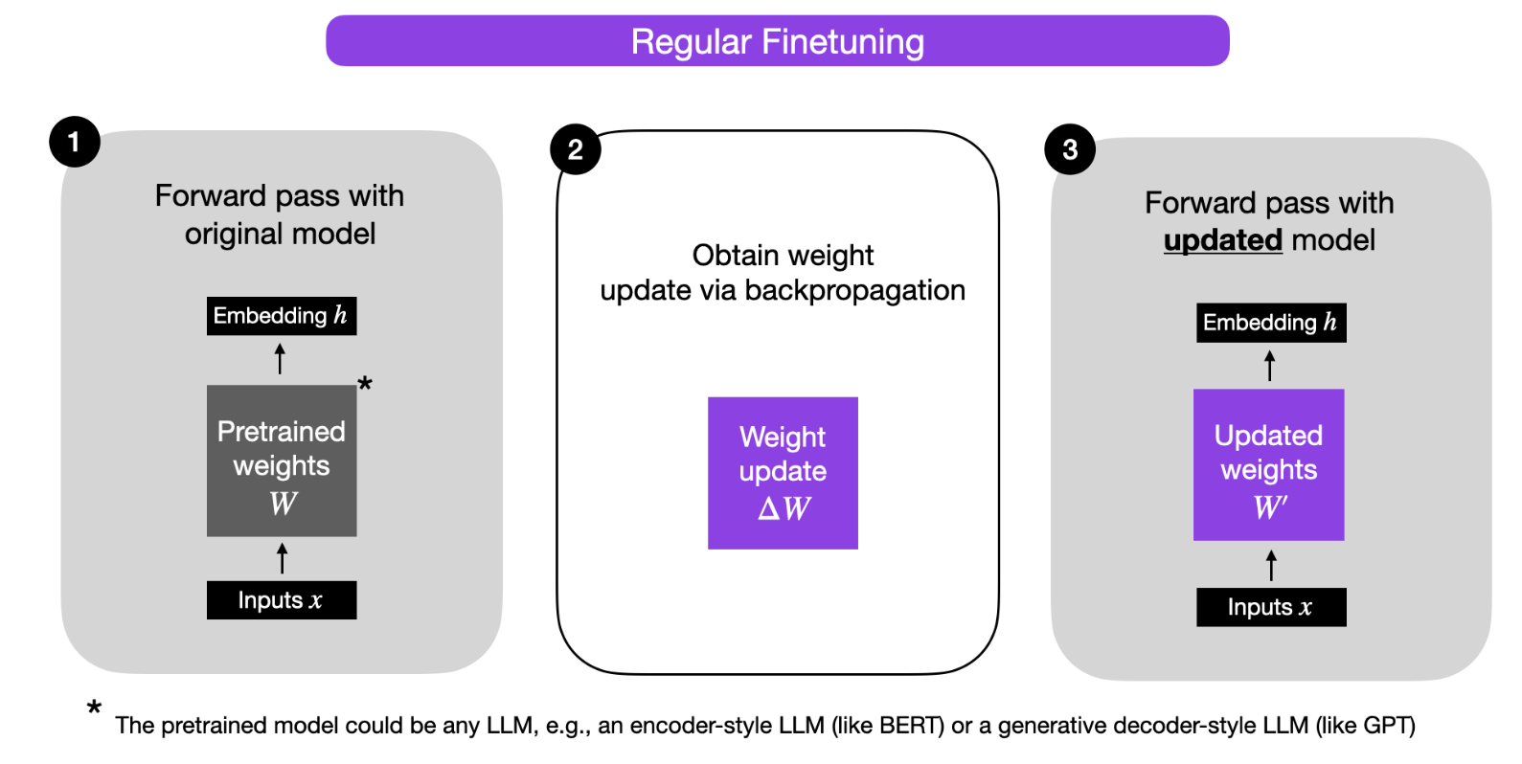
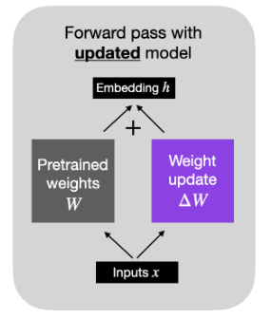
Regular Finetuning
Weight update
ΔW=α(−∇L_{W})
W′=W+ΔW
Alternatively, we can keep the weight update matrix separate and compute the outputs as follows:
h=W x+ΔW x
Problem: W is huge (e.g., 4096x4096), which means ΔW is also huge. Training this ΔW directly is Full Finetuning

Slide 18

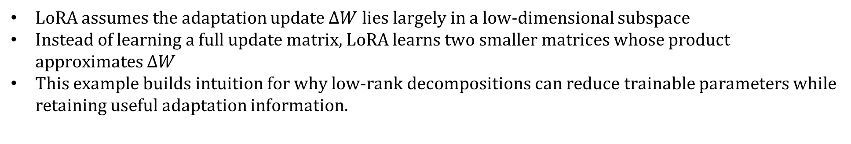
Low-Rank Adaptation
LoRA assumes the adaptation update $ΔW$ lies largely in a low-dimensional subspace
Instead of learning a full update matrix, LoRA learns two smaller matrices whose product approximates $ΔW$
This example builds intuition for why low-rank decompositions can reduce trainable parameters while retaining useful adaptation information.
To store this matrix, we need to save 9 numbers
But look closer at the relationship between the rows
  Row 2 is exactly 2 X Row 1 and row 3 is exactly 0.5 X Row 1
  There is actually only one unique row of information here (10, 20, 30)
  Matrix Size is 3 X 3but Rows are dependent, so the matrix rank is 1
LoRA exploits this
Related to PCA and SVD, where we approximate a high-dim matrix or dataset using a lower-dim representation

Slide 19
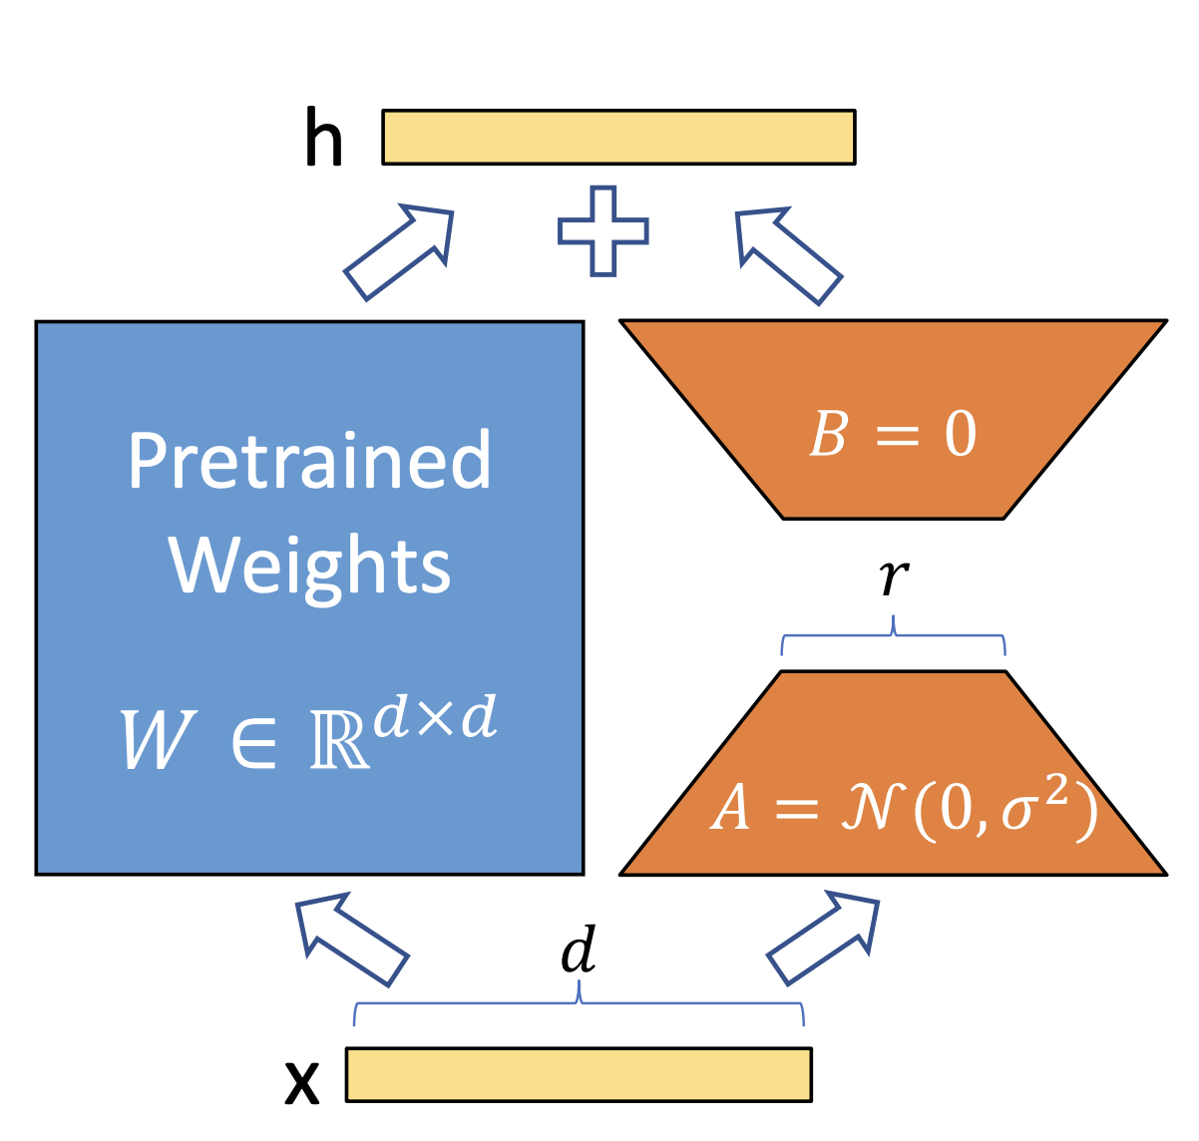
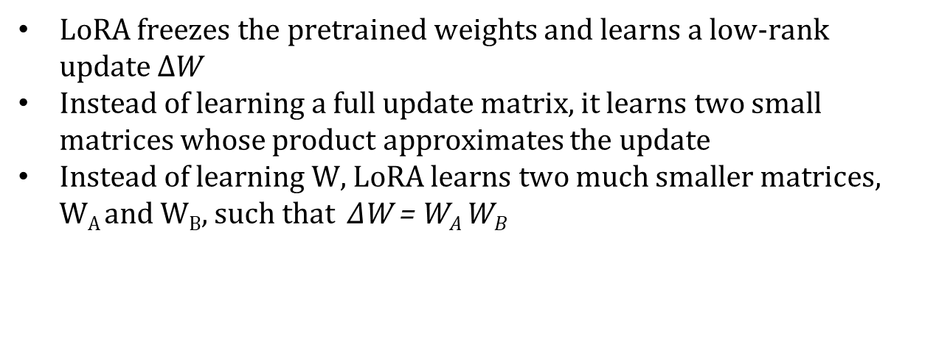
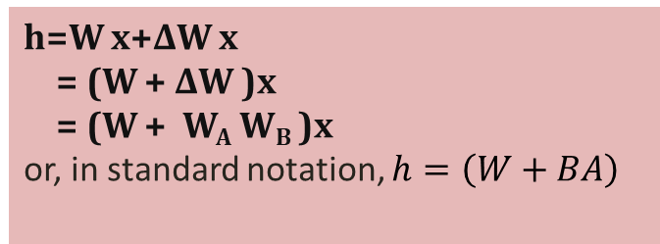
Low Rank Adapters - LoRA
LoRA freezes the pretrained weights and learns a low-rank update $ΔW$
Instead of learning a full update matrix, it learns two small matrices whose product approximates the update
Instead of learning W, LoRA learns two much smaller matrices, W_{A} and W_{B}, such that ΔW = W_{A} W_{B}
Pre-trained weight matrix : W∈R^{A×B}
Decompose weight update matrix into two smaller matrices:
ΔW=W_{A} W_{B}, where W_{A}∈R^{A×r} and W_{B}∈R^{r×B}
Keep the original weight W frozen and only train the new matrices called LORA weights W_{A} and W_{B}
h=W x+ΔW x
= (W + ΔW )x
= (W + W_{A} W_{B} )x
or, in standard notation, $h=\left(W+BA\right)$

Slide 20
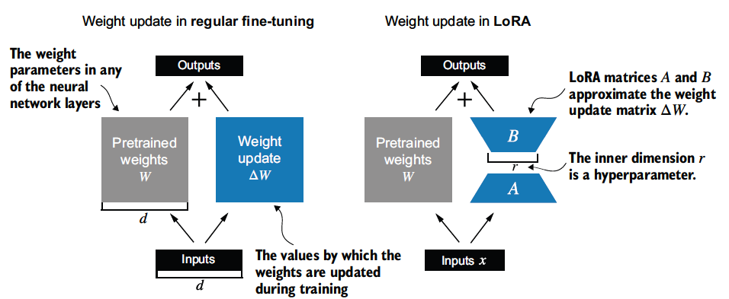

Example
Full update: $ΔW∈ℝ^{10000×20000}$ requires 200,000,000 parameters
With LoRA rank $r=8$: $A∈ℝ^{10000×8}$, $B∈ℝ^{8×20000}$.
LoRA parameters for this layer: $10000×8+8×20000=240,000$.
This is a reduction of about 99.88% compared with the full update for that layer

Slide 21
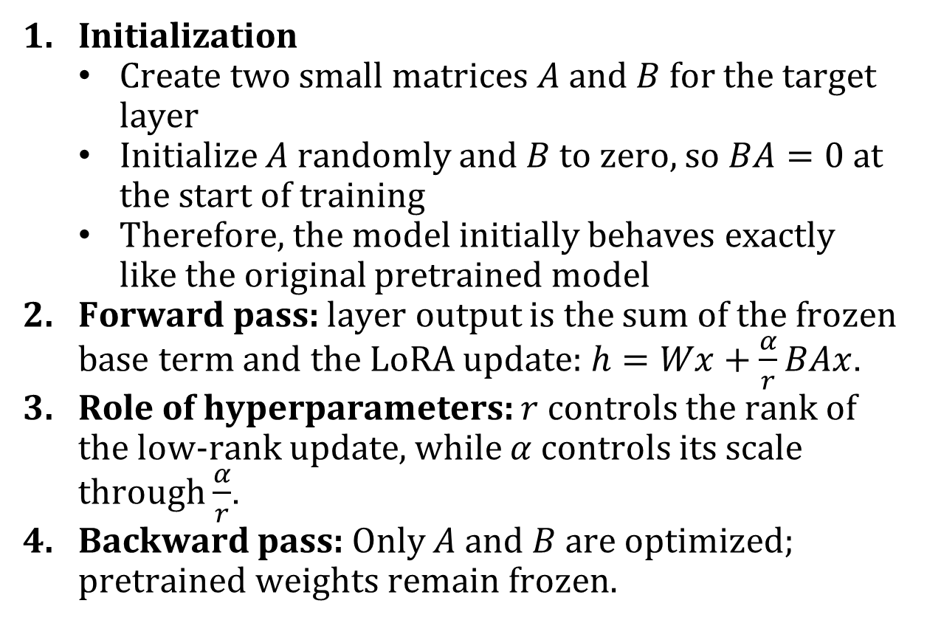
LoRA finetuning process
Initialization
  Create two small matrices $A$ and $B$ for the target layer
  Initialize $A$ randomly and $B$ to zero, so $BA=0$ at the start of training
  Therefore, the model initially behaves exactly like the original pretrained model
Forward pass: layer output is the sum of the frozen base term and the LoRA update: $h=Wx+\frac{α}{r}BAx$.
Role of hyperparameters: $r$ controls the rank of the low-rank update, while $α$ controls its scale through $\frac{α}{r}$.
Backward pass: Only $A$ and $B$ are optimized; pretrained weights remain frozen.

Slide 22
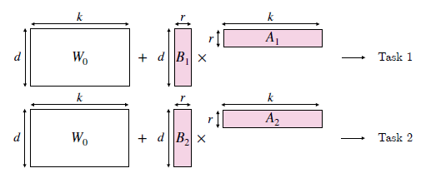

Multi-tenant serving - LoRA
One shared base model can serve many task-specific LoRA adapters.
Different adapter requests can be handled efficiently in the same serving system.
For task $i$: $h=xW_{0}+\frac{α}{r}xB_{i}A_{i}=x \left(W_{0}+\frac{α}{r}B_{i}A_{i}\right)$
Store 1 base model + N LoRA adapters, instead of N full fine-tuned models

Slide 23
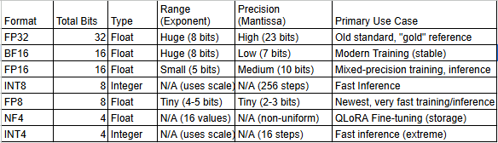
Quantization
Quantization is the process of reducing the precision of a model's parameters (e.g., from 32-bit floating point to 8-bit integer) to reduce model size and latency

Slide 24
QLoRA
PEFT on a quantized model
Load the massive pre-trained model in 4-bit precision (heavily compressed)
But add trainable LoRA adapters in standard 16-bit precision
3 specific technical tricks to make this hybrid precision work without losing accuracy
  A new data type: 4-bit NormalFloat (NF4)
    Designed to be information-theoretically optimal for normally distributed neural-network weights
  Double Quantization
    Quantization uses quantization constants (scales) to reconstruct compressed values, and these constants also consume memory.
    QLoRA further quantizes those quantization constants to reduce memory overhead.
  Paged Optimizers
    These use CUDA unified memory so optimizer states can be paged between GPU memory and CPU memory when GPU memory becomes tight.
    This helps prevent training crashes during memory spikes

Slide 25
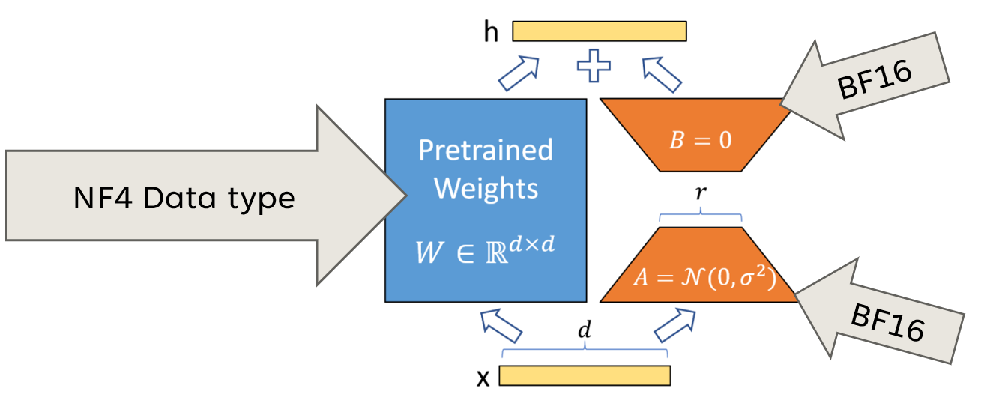
QLoRA fine-tuning
Compression: The pretrained base model is stored in frozen 4-bit NF4 format.
Adapter injection: Small trainable LoRA matrices are added in a higher-precision format, typically bf16/fp16.
Forward pass: Quantized base weights are dequantized on the fly to the compute precision for matrix operations, then discarded after use.
Backward pass: Gradients flow through the computation, but only the LoRA adapter weights are updated; the base weights remain frozen.
Benefit: QLoRA achieves memory-efficient fine-tuning while preserving performance close to higher-precision LoRA or full fine-tuning
QLoRA is LoRA with quantized linear layers in the base model. The adapters are identical to those of LoRA and kept in higher precision (BF16) during QLoRA training.
Image credits : https://docs.nvidia.com/nemo-framework/user-guide/24.09/sft_peft/qlora.html

Slide 26
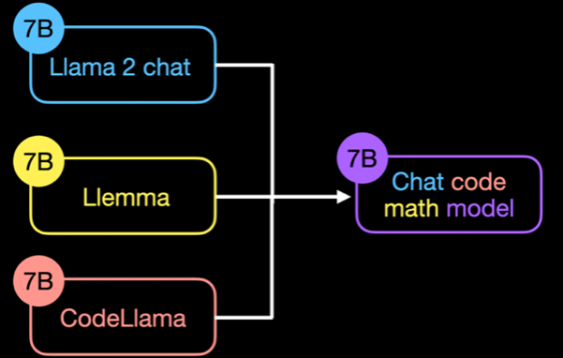
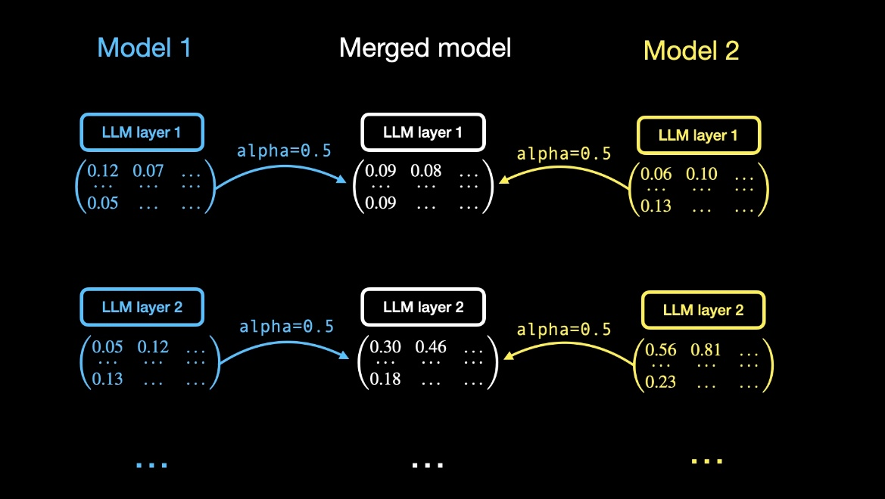
Model Merging: Combining Fine-Tuned Models
Model merging combines two or more compatible fine-tuned models or adapters into a single model.
It is most effective when the models share the same base architecture, and often the same base checkpoint.
Unlike ensembling, merging produces one deployable model, so inference cost does not scale with the number of source models.
A simple example is linear weight averaging, where corresponding parameters from multiple fine-tuned models are averaged.
Model Soups paper showed that averaging multiple fine-tuned models can improve accuracy and robustness without increasing inference time.
Model soups: averaging weights of multiple fine-tuned modelsimproves accuracy without increasing inference time
Image credits : https://lightning.ai/lightning-ai/templates/efficient-linear-model-merging-for-llms?section=featured

Slide 27
References
Book chapters:
Hands-On Large Language Models: Language Understanding and Generation Book by Jay Alammar and Maarten Grootendorst – Ch 12
Speech and Language Processing by Daniel Jurafsky and James H. Martin - Ch -7 and 10
Web references:
https://lightning.ai/pages/community/tutorial/lora-llm/
https://lightning.ai/pages/community/article/understanding-llama-adapters/
https://magazine.sebastianraschka.com/p/practical-tips-for-finetuning-llms
https://magazine.sebastianraschka.com/p/llm-research-insights-instruction
https://lightning.ai/pages/community/article/understanding-llama-adapters/

Slide 28
References
Research Papers:
Prefix-Tuning: Optimizing Continuous Prompts for Generation
Parameter-Efficient Transfer Learning for NLP
Multitask Prompted Training Enables Zero-shot Task Generalization
LORA: LOW-RANK ADAPTATION OF LARGE LANGUAGE MODELS
QLORA:Efficient Finetuning of Quantized LLMs
Model soups: averaging weights of multiple fine-tuned modelsimproves accuracy without increasing inference time
cross task generalization via natural language crowdsourcing instructions
Question Answering on SQuAD 2.0 Dataset
SELF-INSTRUCT: Aligning Language Models with Self-Generated Instructions
SUPER-NATURALINSTRUCTIONS: Generalization via Declarative Instructions on 1600+ NLP Tasks
The Power of Scale for Parameter-Efficient Prompt Tuning
LLAMA-ADAPTER: EFFICIENT FINE-TUNING OF LARGE LANGUAGE MODELS WITH ZERO-INITIALIZED ATTENTION

